Slide 1
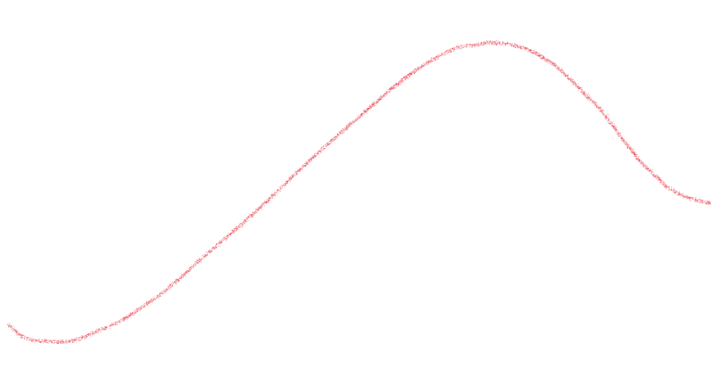
A cycle has 4 phases
It makes sense that the best
time to invest is during
Accumulation.
Distribution
Mark-down
Mark-up
Back to Accumulation and repeat
Accumulation
And step aside and reduce risk
and exposure during mark-down
or corrections

Slide 2
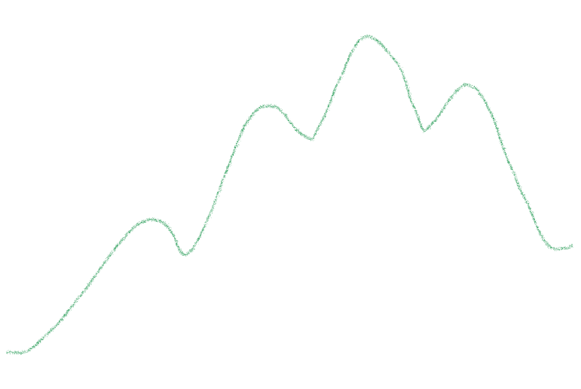
Larger cycles subdivide into several smaller cycles
The Major cycle governs the underlying trend of the smaller cycles
Primary Cycles
The primary cycle has its own accumulation, mark-up, distribution and mark-down phases
Major cycle

Slide 3
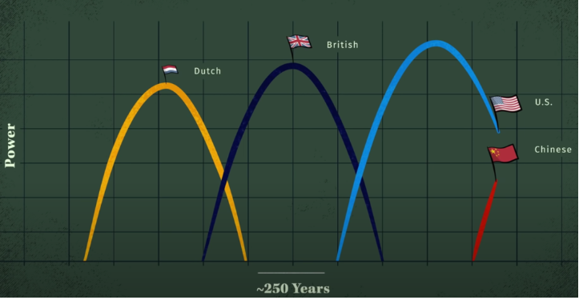
The largest cycle: Superpower Cycle
You are here!

Slide 4
How does the Superpower Cycle breakdown into smaller cycles?
Superpower cycle is 200-250 years (approx)
reasonable to suggest there is a 100+ year cycle (80-120 yrs)
Which would suggest there is a 50 year (40-60yrs)
A 25 year cycle (18-32 yrs)
And a 12-13 year cycle
And so on…

Slide 5
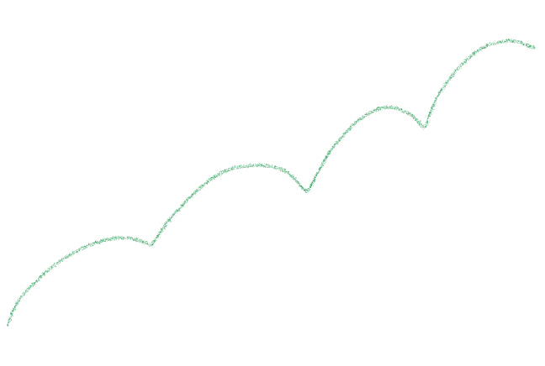
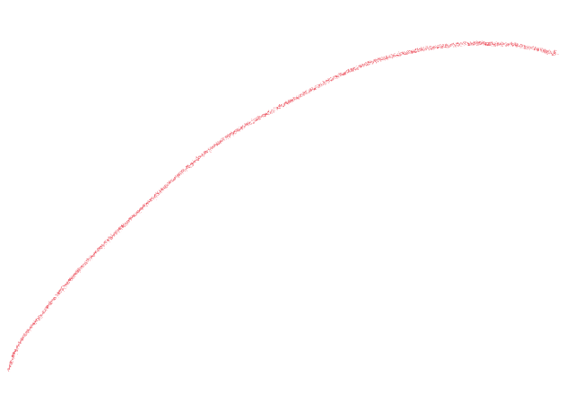
US stocks since 1800s
Superpower Cycle, (approx. 200-250 years)
Smaller Sub-cycles (approx. 50 years)

Slide 6
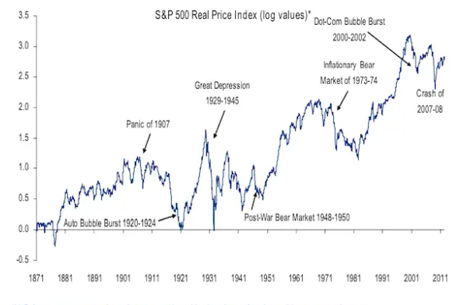
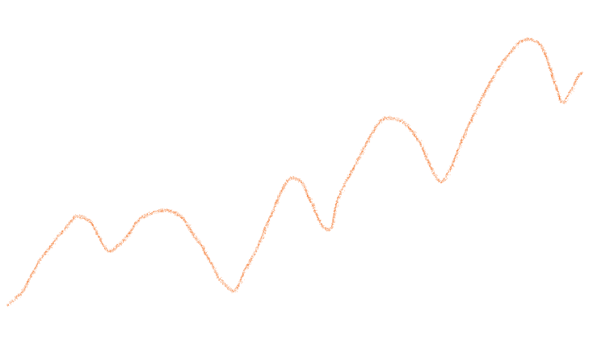
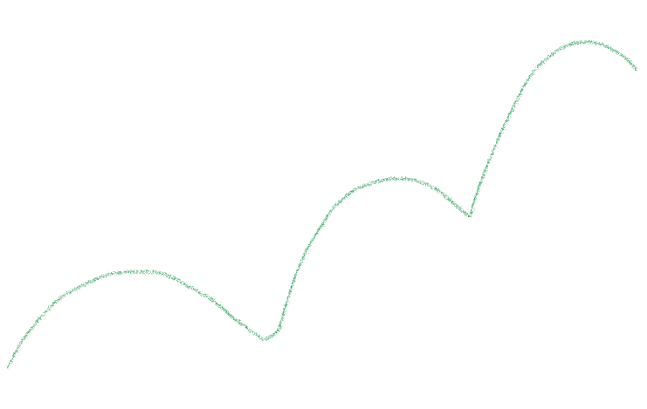
S&P500 Inflation adjusted
50 year cycle
25 year cycle?
1982 – CFG = approx 27 years

Slide 7
What does this mean for us?
Not necessarily WW3
But it does indicate a New World Order
and times of great economic instability and uncertainty ahead
You are still here!

Slide 8
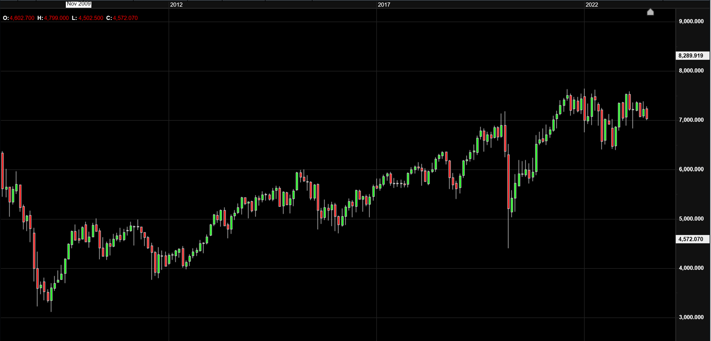
But the cycles will still be there as they always are.
Australia Index Major Cycle
2009 – 2023
Covid
Imagine if you could catch the rises and avoid the dips
GFC
Most investment strategy’s track the rises and dips of the market

Slide 9
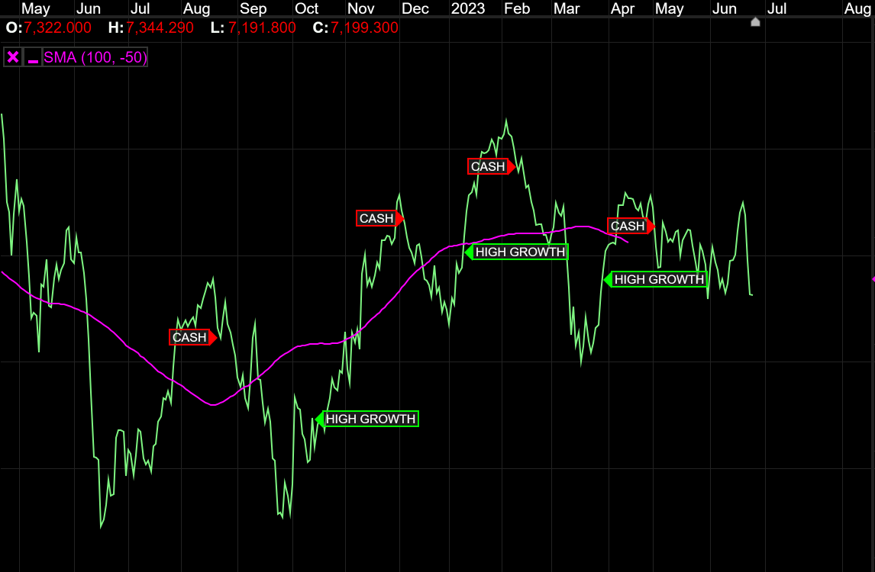

Slide 10
marketcyclescommentary.com

